Slide 1
EXCEL CAPSTONE PROJECT 1 (Analysis of e-commerce dataset)
BY: Sanket B Panve

Slide 2
About the project:
The project deals with descriptive analysis of the dataset chosen from Kaggle.com . The project mainly deals with the study of e-commerce sales dataset of a startup company from Q2 FY2018 to Q1FY2019.
The dataset consists of sales transactions recorded during the period of 12 months. The dataset included 10 columns and 500 rows . The columns included Order ID ,Order Date ,Customer Name, State ,City, Amount ,Profit, Quantity , Category and Sub-Category .
During data preparation , checks for any blanks and NA values was done . Also another column for Sales was added which was derived by Amount and Quantity
Further to this, columns for calculating RFM score were added and customer segmentation was performed for customer base analysis.
The study will help the startup to compare their current (after pandemic) business with the before business scenario. This study will also help the startup to dive deep and gain insights about their customer base, product performance and sales for the previous year and to strategize and take decisions accordingly to improve their sales and profits.

Slide 3
PROBLEM STATEMENT:
The pandemic led to difficult times for all businesses , this startup which had a great
first quarter for FY2020 needs to retrospect the transactions in order to derive some
insights . Following questions will help the Startup to gain better insights:
Which was the best quarter for the startup in terms of sales and profits?
Which particular months they started gaining positive profits ?
Does the gain in profits related to number or quantity of orders received?
Which regional zone performed well?
Which states and cities where the best and least sales generating ?
Which product was sold the most and least?
Which product gave the highest and lowest sales?
Which product contributed to highest and lost profits?
Which product category contributed to largest and smallest share of sales?
Which product category contributed to largest and smallest share of profits?
Which group of customers are more loyal ,more valuable for this business?

Slide 4
Best and worst performing quarters:
In terms of sales Quarter 1 FY2019 was the most best performing quarter whereas Quarter 3 of FY2018 was the worst for the Startup.
In terms of profits Quarter 1 FY2019 was the most best performing quarter whereas Quarter 2 FY2018 was the worst for the Startup.

Slide 5
Best and worst performing months:
In terms of sales March 2019 was the most best performing month whereas July 2018 was the worst for the Startup.
In terms of profits November 2018 was the most best performing month whereas June 2018 was the worst for the Startup.
October was the first month when the Startup started gaining positive profits.

Slide 6
Reason behind increase in profit:
The graph indicates that the profit is highly co-related to the number of orders received .
The startup will have to sell a huge number of products to gain higher profits.

Slide 7
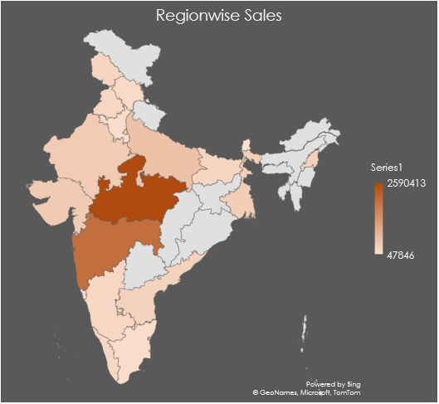
Best performing zone:
As per the map chart of given data, the west zone of country performed the best in terms of sales
Sales in East and North zone was observed less compared to other zones.

Slide 8
City wise sales performance:
As per the data of transactions, Indore and Mumbai found to be the best performing cities in terms of sales whereas Amritsar and Gangtok are cities with least sales.
Best performing state:
As per the data of transaction , Madhya Pradesh and Maharashtra found to be the best performing states in terms of sales whereas Tamil Nadu and Sikkim are states with least sales.

Slide 9
Product sales and order:
As per the chart of given data, Stole was the highest ordered as well as highest sales generating product.
As per the chart of given data, Tables was the least ordered as well as least sales generating product.
As per the chart of given data, Stole and handkerchief are best performing category.
As per the chart of given data, trousers and phones are the least profitable categories.

Slide 10
Category wise sales:
As per the chart of given data, clothing contributes to maximum sales and furniture has least sales.
As per the chart of given data, clothing contributes to maximum profit and electronics contributed .

Slide 11
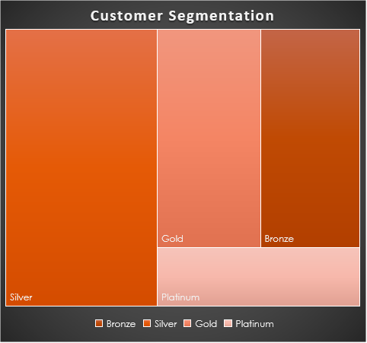
Customer segmentation:
As per the recency ,frequency and monetary score derived from the transactions ,customers were segmented accordingly into 4 groups namely Bronze ,Silver ,Gold and Platinum.
As per the study it is observed that the Platinum type customers having the best series of RFM score contribute less customer share whereas customer base having average and below average RFM score having Gold and Bronze type contribute to near about same customer share . Also it is observed above average RFM score customers forming the silver type contributes to largest share of customers.

Slide 12
Conclusion:
From the study ,it is evident that the startup picked up a great hike in order after substantial failures in initial quarters and they need to keep on increasing orders by marketing or pushing products through effective channelizing.
The study showed that initial quarters faced losses might be due to heavy discounts offered by the Startup at launching phase. The profit surged and dropped,due to improper pricing of the products , hence the pricing of products should be corrected and implemented to get consistent profits for the Startup.
The Startup has performed well at national level having a good nationwide spread of their customers .It was observed the states and cities in west and south region brought more business compared to other zones . Hence to get a good business spread the Startup must position their products by implementing local marketing or other strategies.
The product portfolio indicated that clothing gave more orders and profit , furniture brought less orders but gave collective losses and furniture gave an average sales and order figures. Hence the logistics, warehouses storage, delivery should be planned accordingly.
The customer segmentation showed the platinum customers are less and customers with average scores are having best customer share , this is a good sign for the business . The Startup must try to shift silver type to gold and platinum and to shift bronze customers to silver or gold and to retain platinum customers by planning some offers, discount schemes , memberships,etc

Slide 13
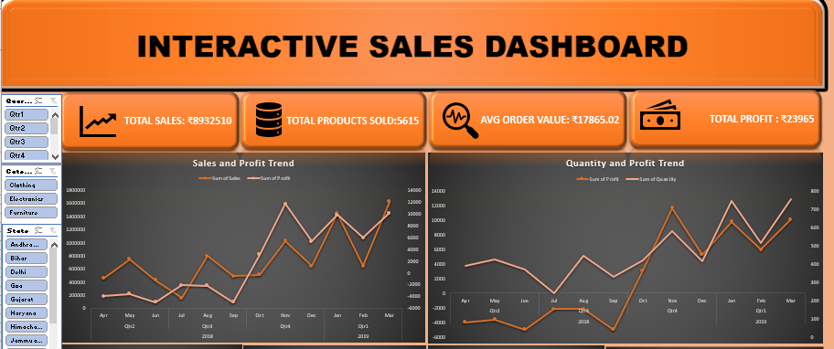
DYNAMIC DASHBOARD PREVIEW

Slide 14
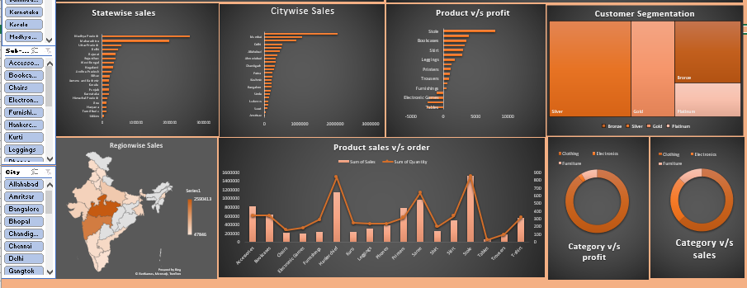
DYNAMIC DASHBOARD PREVIEW

Slide 15
PROJECT LINK
https://drive.google.com/drive/folders/1cT26dVK53QT8XJJSC2oupqKuVwaC8EIV?usp=sharing
VIDEO PRESENTATION LINK
https://drive.google.com/file/d/1IHum4NL5kb5Y5N4V6-b9a7VjG8OBez1B/view?usp=sharing

Slide 16
THANKYOU

